Slide 1
MicroController
Instructor: PhD. Nguyen Vu Anh Quang
Faculty of CE

Slide 2
Giới thiệu
Tên học phần: Vi điều khiển
Số tín chỉ: 02TC (Lí thuyết)+1TC Thực hành
Syllabus

Slide 3
Objectives
Introduction fundamentals and applications of microprocessors and microcomputers.
Architecture, the instruction set, and applications of 8051 microcontroller family
Basic applications of microprocessors, such as input/output, analog-digital conversion (ADC), and digital-analog conversion (DAC), and data acquisition.
Aspects of KIT Arduino
Ref. I. Scott Mackenzie
2

Slide 4
Textbooks
I. Scott Mackenzie, Raphael C, -W, The 8051 Microcontroller, Prentice Hall, Fourth edition.
James A. Langbridge, Arduino sketches – Tools and techniques for programming , Wiley
Tống Văn On, Hoàng Đức Hải, “Họ vi điều khiển 8051”, 2001.
Nguyễn Tăng Cường, “Cấu trúc và lập trình họ VĐK 8051”, 2003
Ref. I. Scott Mackenzie
3

Slide 5
Chapter 1 Introduction to Microcontrollers
Ref. I. Scott Mackenzie
4

Slide 6
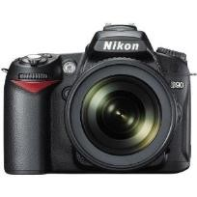

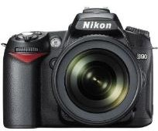



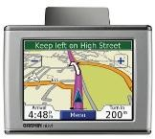

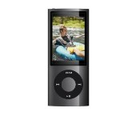
These are …
embedded systems
An embedded system is a system in which a processor/microcontroller/computer is embedded to
perform a specific task or tasks
Ref. I. Scott Mackenzie
5

Slide 7
Microprocessors
 | Control Unit (CU)
 | Arithmetic Logical Unit (ALU)
Central Processing Unit (CPU)
Integrated ALU and CU
No RAM, ROM, I/O on CPU chip itself
Example: Intel’s x86, Motorola’s 680x0
Many chips on mother’s board
Data Bus
CPU General- Purpose Micro- processor
 |  | RAM |  |  | ROM |  |  | I/O Port |  |  | Timer |  |  | Serial Port
Address Bus
Ref. I. Scott MGackeennzieeral-Purpose MiLcê Crhoí Thpônrgocessor System
6

Slide 8
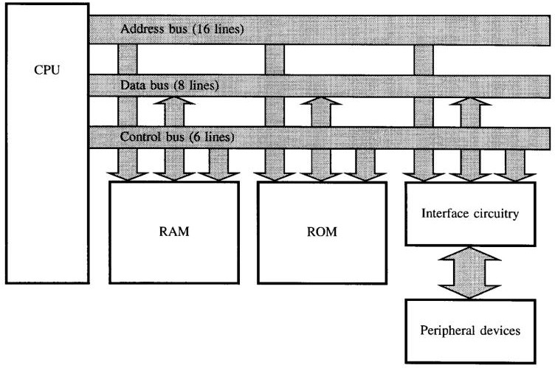
FIGURE 1–2
Block diagram of a microcomputer system
Architecture of computers
Ref. I. Scott Mackenzie
7

Slide 9
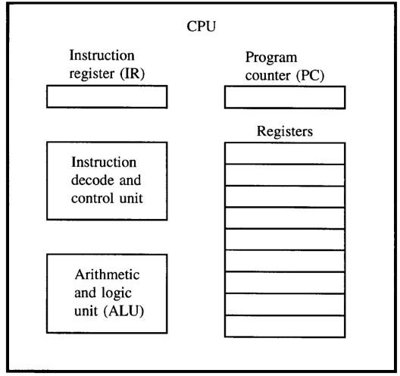
FIGURE 1–3
The central processing unit (CPU)
Architecture of CPU
PC-
Program counter
Ref. I. Scott Mackenzie
8

Slide 10
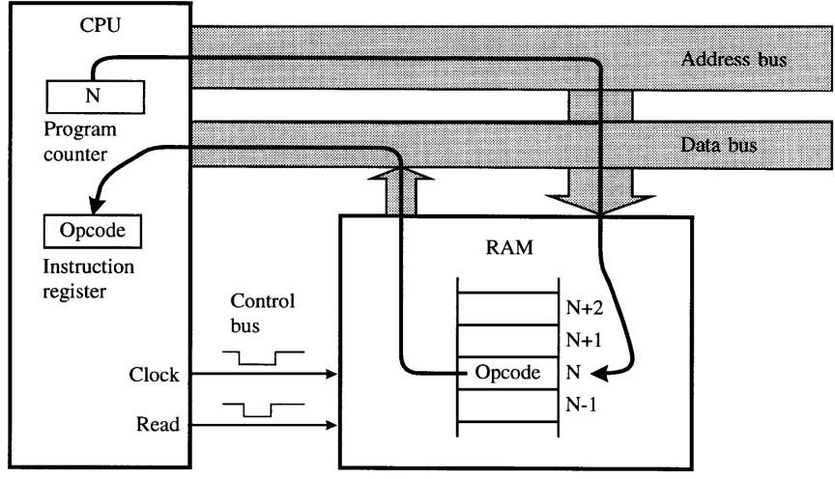
FIGURE 1–4
Bus activity for an opcode fetch cycle
Opcode fetch, decode, execution
Ref. I. Scott Mackenzie
9

Slide 11
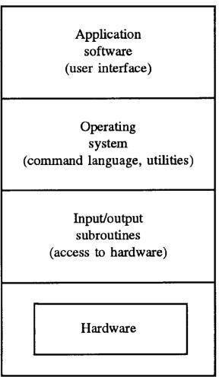
FIGURE 1–5
Levels of software
Shell, GUI – user
- hardware
Utilities
Booster loader, BIOS
Keyboard, monitor Other hardwires
Ref. I. Scott Mackenzie
10

Slide 12
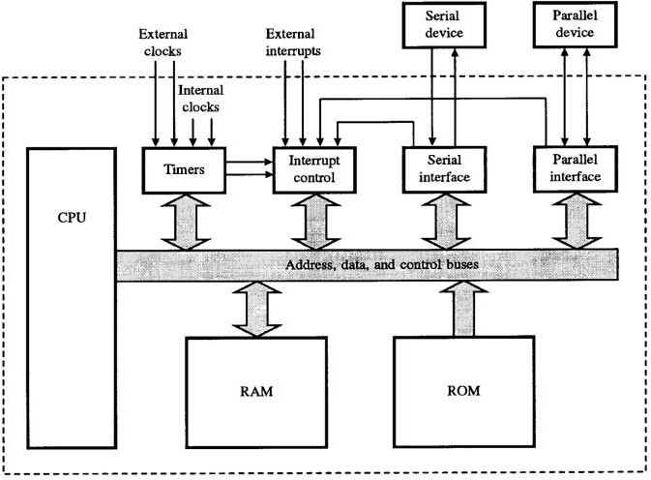
FIGURE 1–6
Detailed block diagram of a microcomputer system
Ref. I. Scott Mackenzie
11

Slide 13
Microcontrollers
Integrates CPU, RAM, ROM, I/O ports, … on a single chip
Sometimes called a "computer on a chip"
Typically used in embedded applications
Example: Motorola’s 6811, Intel’s 8051, Zilog’s Z8
and PIC 16X
A single chip
CPU | RAM | ROM
I/O Port | Timer | Serial COM Port
Ref. I. Scott MackeMnzieicrocontroller
12

Slide 14
Microprocessor vs. Microcontroller
Microprocessor
CPU is stand-alone, RAM,
ROM, I/O, timer are separate
designer can decide on the amount of ROM, RAM and I/O ports.
expansive
versatility
general-purpose
Microcontroller
CPU, RAM, ROM, I/O and
timer are all on a single chip
fix amount of on-chip ROM, RAM, I/O ports
Highly bit addressable
for applications in which cost, power and space are critical
single-purpose

Slide 15
Microcontroller Architectures
Memory
CPU
Address Bus⁰
Data Bus
Program
+ Data
Von Neumann Architecture
₂n
Memory
CPU
Address Bus⁰
Fetch Bus
Program
Harvard Architecture
Address Bus 0
Data Bus
Data
Ref. I. Scott Mackenzie
13

Slide 16

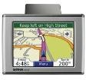
Embedded System
Embedded system: the processor is embedded into that application.
An embedded product usually uses a microcontroller to do one task only.
In an embedded system, there is only one application software that is typically burned into ROM
Ref. I. Scott Mackenzie
14

Slide 17
Embedded System
Sensor conditioning
sensor
Output interfaces
Microcontroller (uC)
actuator
sensor
indicator
sensor
Ref. I. Scott Mackenzie
15

Slide 18
Representation of Number Systems
Positive radix, positional number systems
A number with radix r is represented by a string of digits:
^{A}n - 1^{A}n - 2 ^{… A}1^{A}0 ^{. A}- 1 ^{A}- 2 ^{… A}- m + 1 ^{A}- m
in which 0 < A_{i} < r and . is the radix point.
The string of digits represents the power series:
( ) (
)j
i = n - 1
j = - 1
∑ ∑
(Number)r
=
i
+
A_{i} r A_{j} r
i = 0 j = - m
(Integer Portion) ⁺ (Fraction Portion)
Ref. I. Scott Mackenzie
16

Slide 19
Representation of Number Systems
 |  | General | Decimal | Binary
Radix (Base) |  | r | 10 | 2
Digits |  | 0 => r - 1 | 0 => 9 | 0 => 1
 | 0 | _{r}0 | 1 | 1
 | 1 | _{r}1 | 10 | 2
 | 2 | _{r}2 | 100 | 4
 | 3 | _{r}3 | 1000 | 8
Powers of | 4 | _{r}4 | 10,000 | 16
Radix | 5 | _{r}5 | 100,000 | 32
 | -1 | _{r} -1 | 0.1 | 0.5
 | -2 | _{r} -2 | 0.01 | 0.25
 | -3 | _{r} -3 | 0.001 | 0.125
 | -4 | _{r} -4 | 0.0001 | 0.0625
 | -5 | _{r} -5 | 0.00001 | 0.03125
Ref. I. Scott Mackenzie
17

Slide 20
Decimal (Radix r = 10)
4 | 0 | 7 | . | 6 | 2 | 5
10² | 10¹ | 10⁰ | . | ₁₀-1 | ₁₀-2 | ₁₀-3
4x10² | 0x10¹ | 7x10⁰ | . | 6x10⁻¹ | 2x10⁻² | 5x10⁻³
400 | 0 | 7 | . | 0.6 | 0.02 | 0.005
400 + 0 + 7 + 0.6 + 0.02 + 0.005
Binary (Radix r = 2)
= 407.625
1 | 0 | 1 | . | 0 | 1 | 1
₂2 | ₂1 | ₂0 | . | ₂-1 | ₂-2 | ₂-3
1x2² | 0x2¹ | 1x2⁰ | . | 0x2⁻¹ | 1x2⁻² | 1x2⁻³
4 | 0 | 1 | . | 0 | 0.25 | 0.125
101.011 B = 4 + 0 + 1 + 0 + 0.25 + 0.125
Ref. I. Scott Mackenzie
= 5.375
18

Slide 21
Hexadecimal or Hex (Radix r = 16)
Hexadecimal | Decimal | Binary
0 | 0 | 0000
1 | 1 | 0001
2 | 2 | 0010
3 | 3 | 0011
4 | 4 | 0100
5 | 5 | 0101
6 | 6 | 0110
7 | 7 | 0111
Hexadecimal | Decimal | Binary
8 9 A B C D E F | 8 9 10 11 12 13 14 15 | 1000 1001 1010 1011 1100 1101 1110 1111
5 | A | 0 | . | 4 | D | 1
16² | 16¹ | 16⁰ | . | ₁₆-1 | ₁₆-2 | ₁₆-3
5x16² | 10x16¹ | 0x16⁰ | . | 4x16⁻¹ | 13x16⁻² | 1x16⁻³
1280 | 160 | 0 | . | 0.25 | 0.0508 | 0.0002
5A0.4D1 H = 1280 + 160 + 0 + 0.25 + 0.0508 + 0.0002
Ref. I. Scott Mackenzie
= 1440.301
19

